Slide 1
Pharmacy Management System
Submitted By
SAQIB AHMED. O
(Register No: 31918P19004)
Mazharul Uloom College,
Ambur – 635802.

Slide 2
Introduction
The main purpose of this Pharmacy Management System project is to improve the maintenance and manipulation of the drugs in the medicals.
The pharmacy management system will be used to minimize the time and resource by maintaining the details of the drug systemically so that the data can be used in possible quickest time. While the resource which is minimized are workforce, money, papers, etc.
This system is user-friendly and will help the pharmacist, in all forms of dealing with pharmacy and it will reduce the burden on pharmacist and will make the system efficient by providing the more accurate details about drugs in the medical.

Slide 3
System Configuration

Slide 4
System Design
Architectural Design
ADMIN
Login Validation
Unauthorized
Pharmacy Management System

Slide 5
Context Level Diagram
Pharmacy Management System
Products
Billing
Customer
Supplier
Purchase
Order

Slide 6
Level One Diagram
Purchase
Products
Billing
Sale
Supply products
Supplier
Order products
Product Information
Bill to Customer
Sale products
Customer
Order products

Slide 7
Project Description
Problem Definition:
The Owner of the pharmacy needs to maintain the products details in notebooks. They need to search for the products manually . Whether the products need to buy or not. Not available of the quantity of the stock. Need to Bills manually for the sale of the products medicine. To avoid these kind of problems we are making it as system wise billing mechanism. The Expiry date of the each products is cannot be maintain manually. This can be achieved with the help of the system.
Module Description:
Administrator
Medicine Search
Medicine Information
Purchase information
Sale Information
Order of the Medicine.

Slide 8
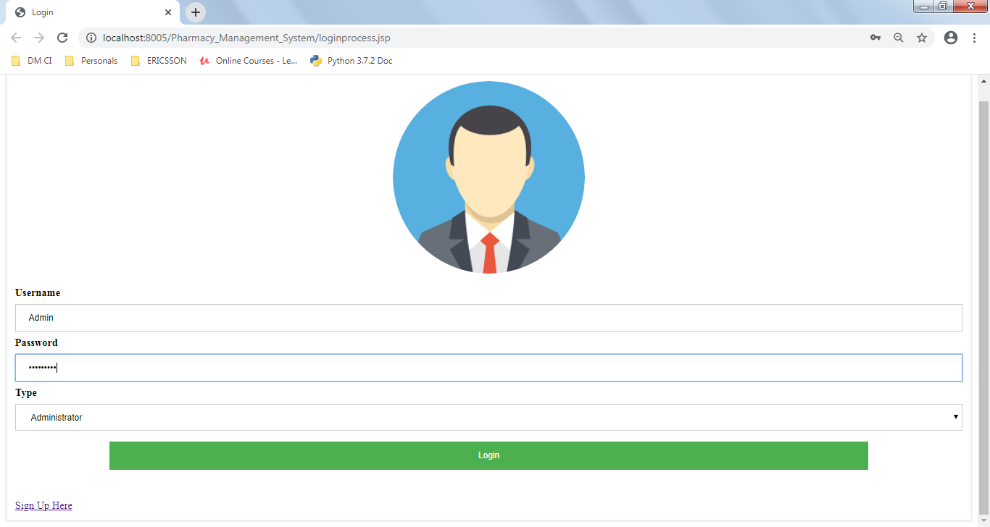
Screen Shot
Admin Login:

Slide 9
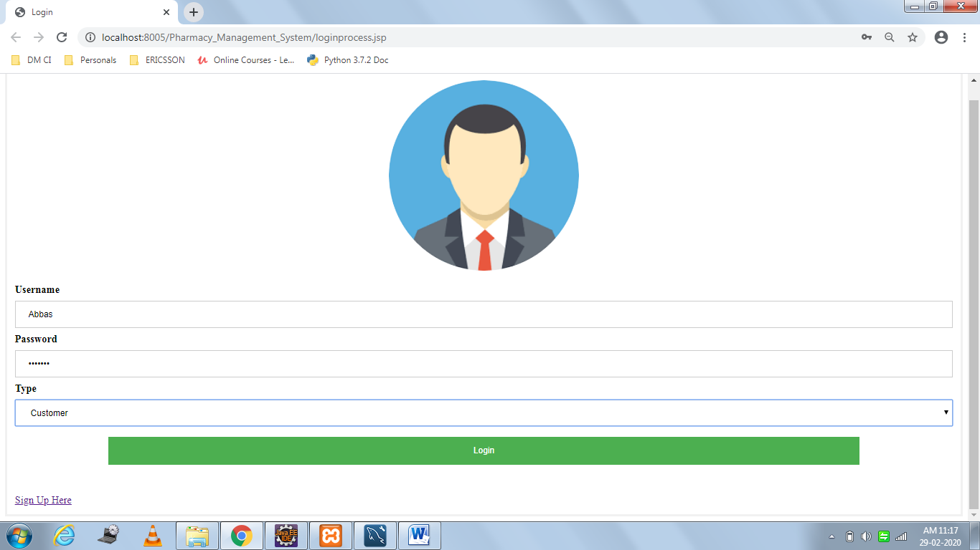
Screen Shot
Customer Login:

Slide 10
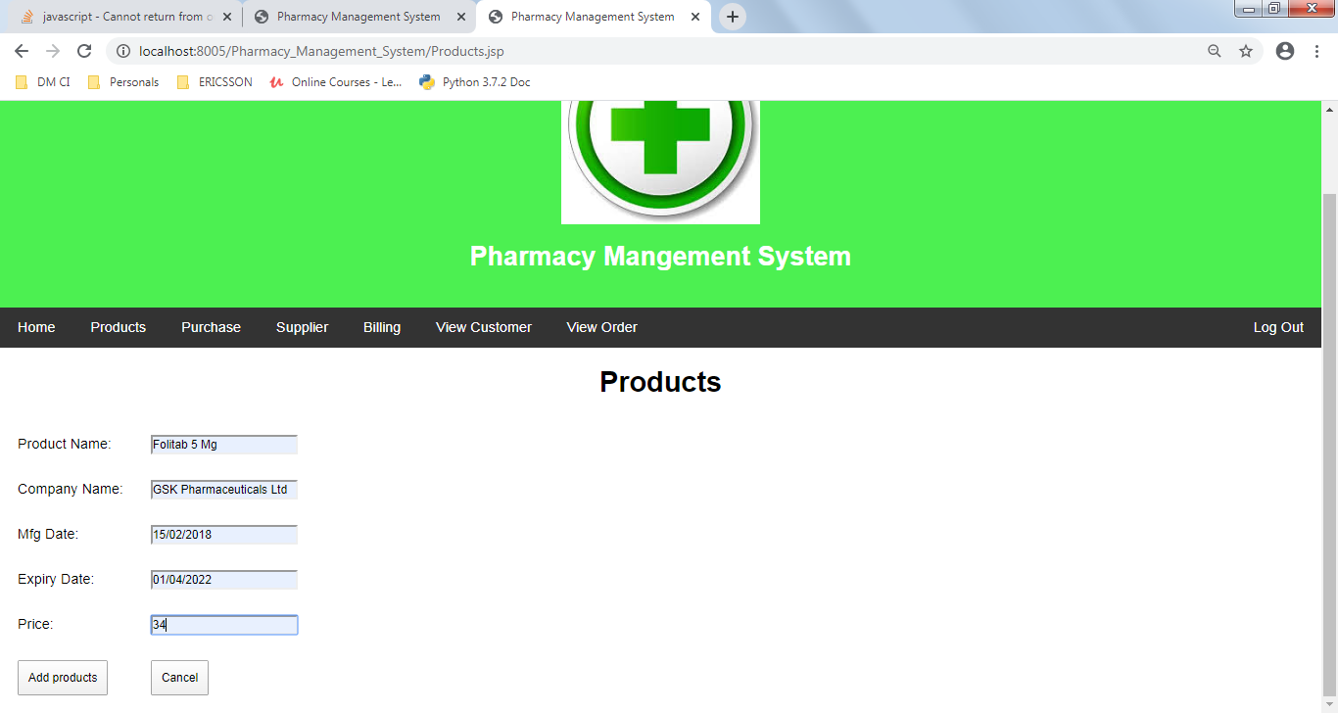
Screen Shot
Add Products:

Slide 11
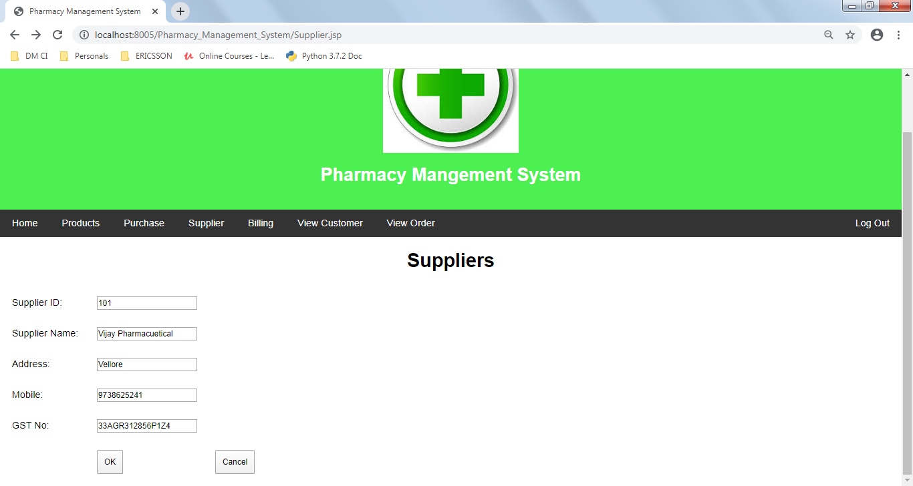
Screen Shot
Add Supplier:

Slide 12
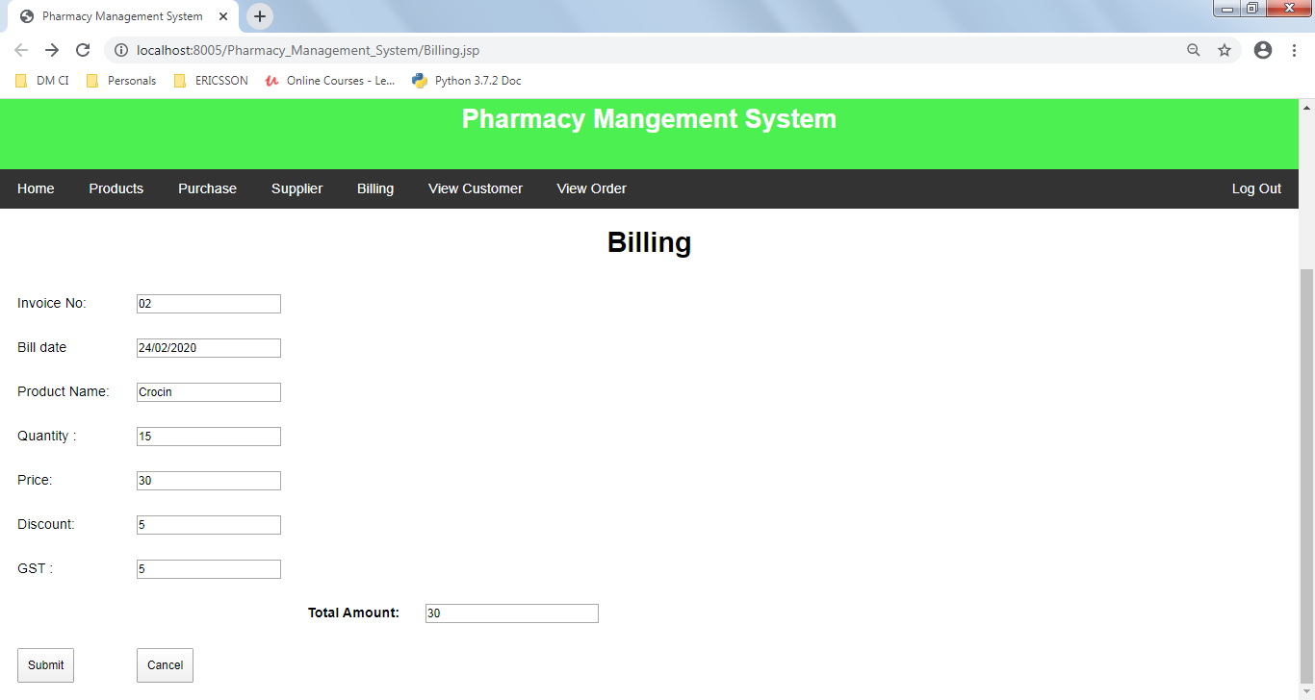
Screen Shot
Billing to Customer:

Slide 13
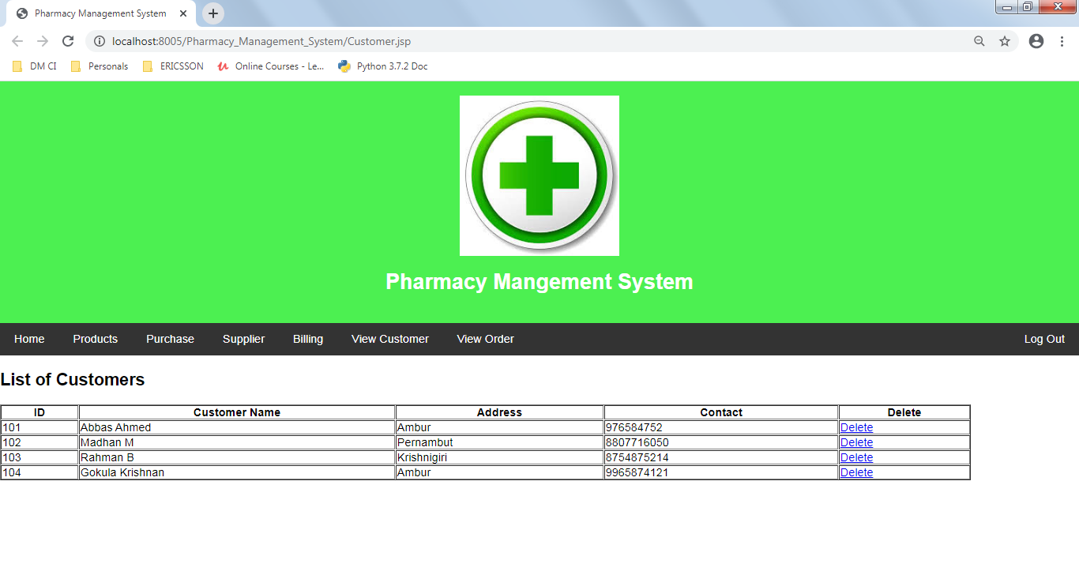
Screen Shot
Customer View:

Slide 14
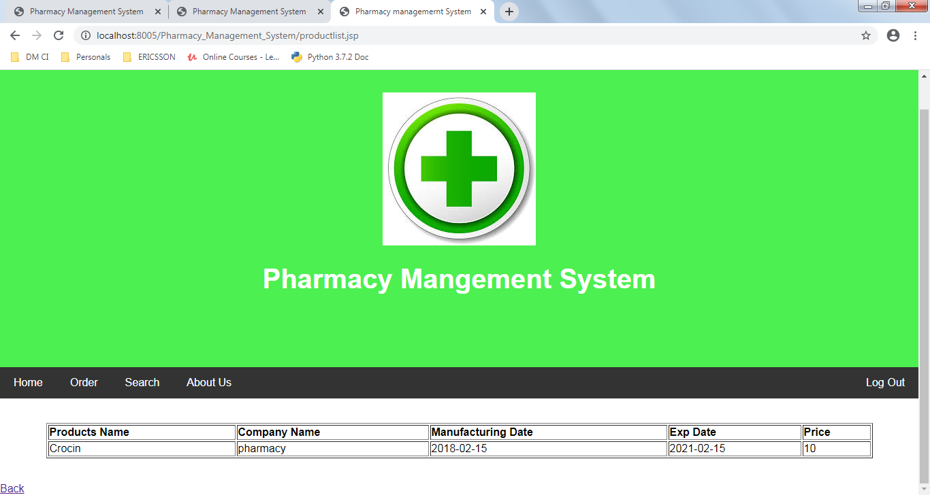
Screen Shot
Product List:

Slide 15
Conclusion
This Projects ”Pharmacy Management System” has been developed to provide and overcome the problem faced by the present system.
The developed package was found to work out the operation in the present system. The developed package was found to work out the operation effectively. The objective was to reduce inconsistency, limiting redundancy , accessing data within less time to be achieved. It is user friendly, fast, secure and optimized. It helps to manage and provide more efficiency in work. This Projects is highly flexible for future addition and can adapt to any requirement.

